Slide 1
What is Personal Development?
Personal development is looking inward and focusing on ways to better yourself. Personal development increases your self-awareness, your self-esteem, increases your skills, and fulfills your aspirations.
Kaung Myat Thu,Aung Kyaw Htay,Pyae Phyo Maung

Slide 2
5 areas of personal development
Mental
Social
Spiritual
Emotional
Physical
Kaung Myat Thu,Aung Kyaw Htay,Pyae Phyo Maung

Slide 3
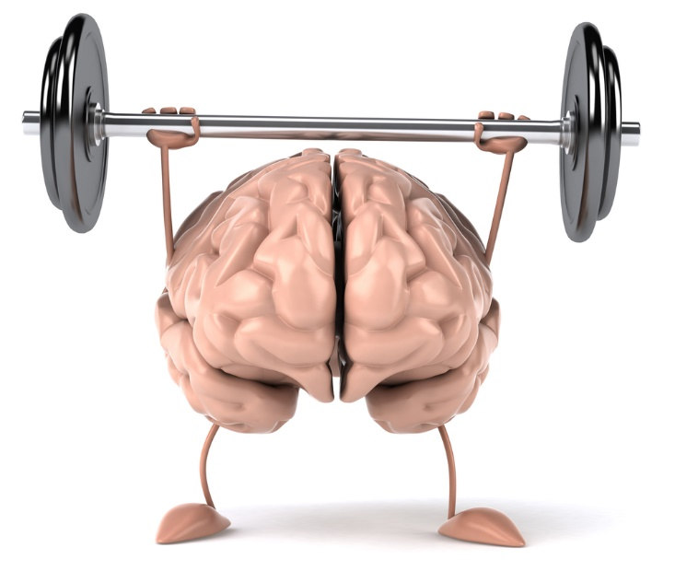
Mental
Rest
Exercise Your Brain
Staying Mentally Fit
Kaung Myat Thu,Aung Kyaw Htay,Pyae Phyo Maung

Slide 4

Social
Social Connections
Communication Skills
Kaung Myat Thu,Aung Kyaw Htay,Pyae Phyo Maung

Slide 5
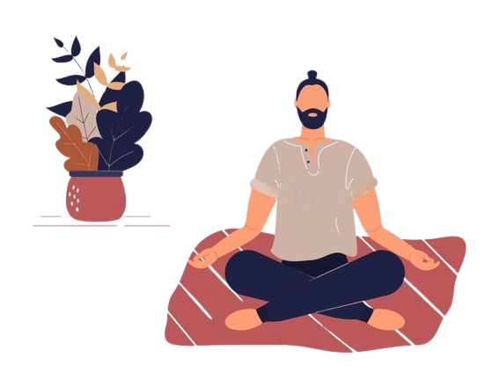
Spiritual
Meditation
Trying to know yourself
Kaung Myat Thu,Aung Kyaw Htay,Pyae Phyo Maung

Slide 6
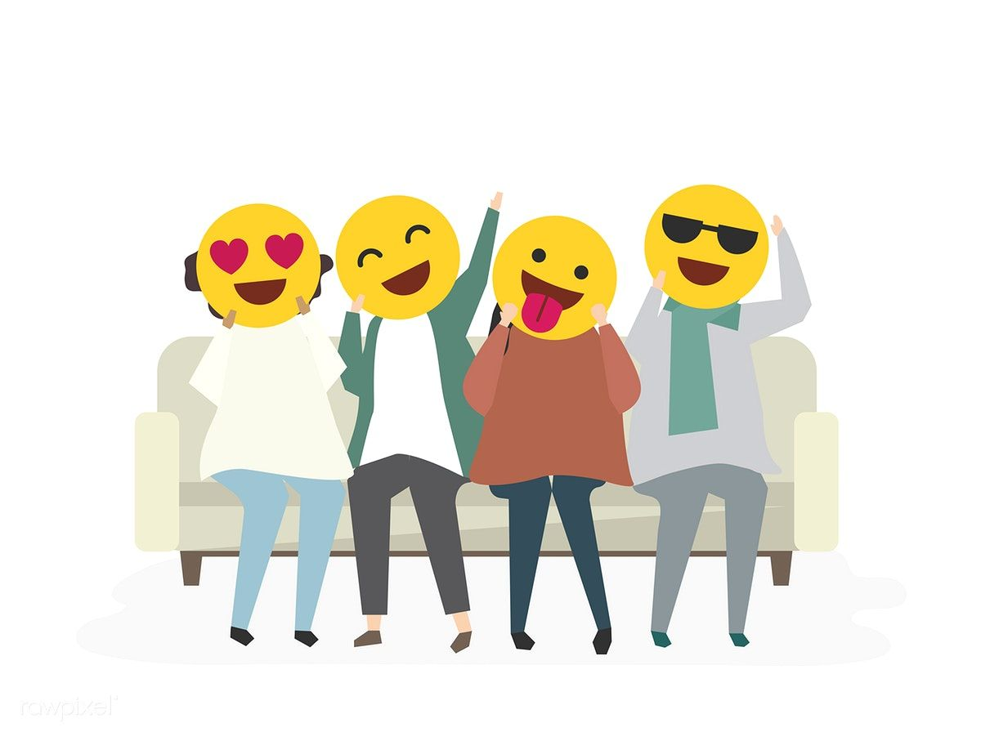
Emotional
Emotional Intelligence
Your own inner work
Kaung Myat Thu,Aung Kyaw Htay,Pyae Phyo Maung

Slide 7
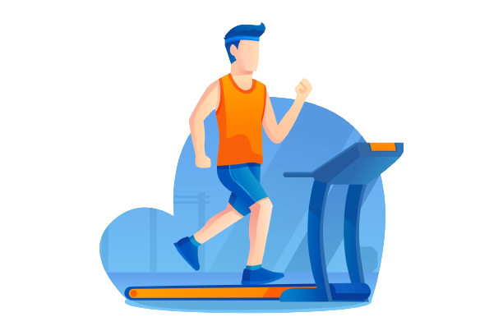
Physical
Physical Exercise
Work out
Kaung Myat Thu,Aung Kyaw Htay,Pyae Phyo Maung

Slide 8
The benefits of personal development
Increased self-awareness and self-esteem.
Increased mental fitness
Greater resilience
More knowledge and learned skills
Improved personal and professional relationships
Kaung Myat Thu,Aung Kyaw Htay,Pyae Phyo Maung

Slide 9
5 steps to developing a personal development plan
Identify areas where you’d like to improve
Work with a coach or mentor to assemble a plan
Structure your personal development goals
Find an accountability buddy
Be honest and aware of your progress
Kaung Myat Thu,Aung Kyaw Htay,Pyae Phyo Maung

Slide 10
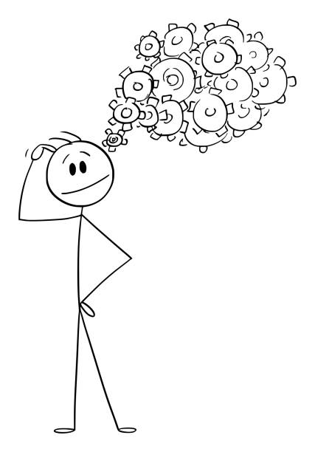
Identify areas where you’d like to improve
Your personal goal
Where you want to improve
Kaung Myat Thu,Aung Kyaw Htay,Pyae Phyo Maung

Slide 11
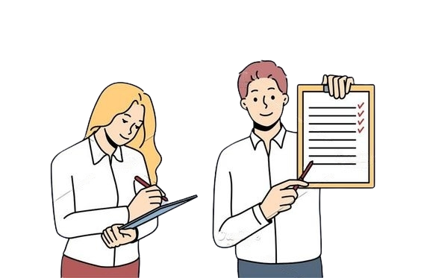
Work with a coach or mentor to assemble a plan
train with life coach
Why should we train?
Kaung Myat Thu,Aung Kyaw Htay,Pyae Phyo Maung

Slide 12

Structure your personal development goals
Plans of each your personal goals
Building new habits
Kaung Myat Thu,Aung Kyaw Htay,Pyae Phyo Maung

Slide 13
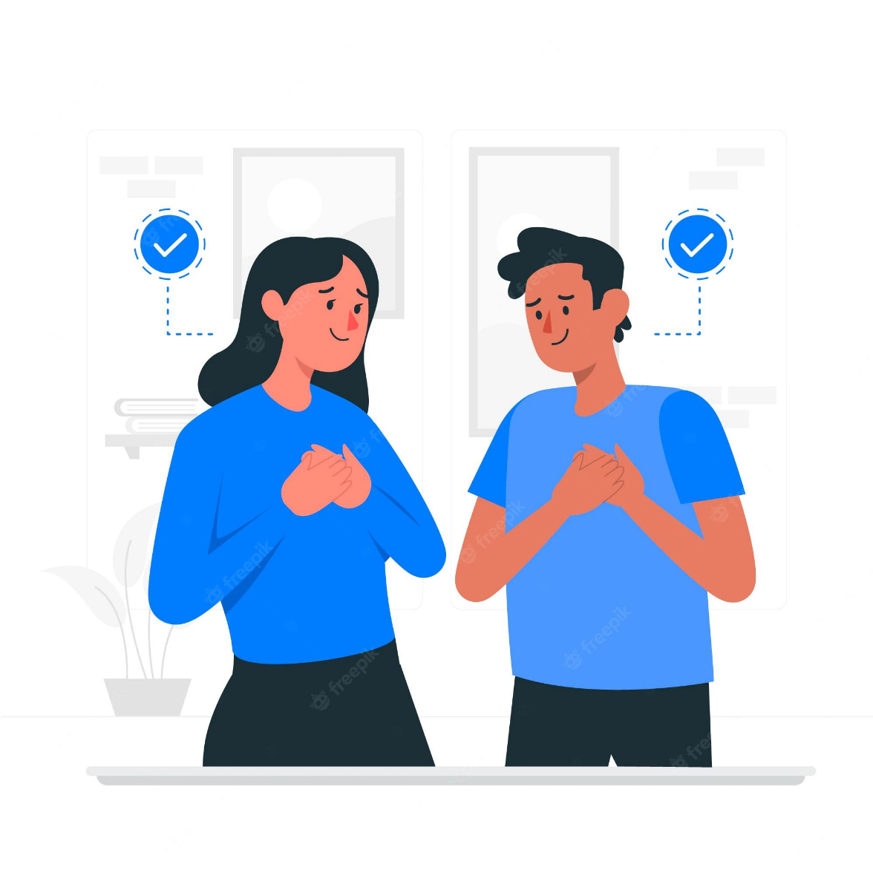
Be honest and aware of your progress
Require integrity.
Accept your saturation.
Take feedback from friends and families for your goals.
Kaung Myat Thu,Aung Kyaw Htay,Pyae Phyo Maung

Slide 14
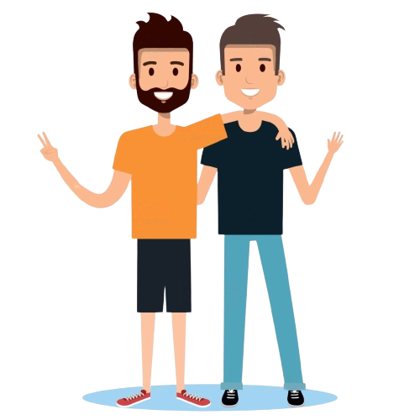
Find an accountability buddy
May be old friends or new friends
To support each our goals
Kaung Myat Thu,Aung Kyaw Htay,Pyae Phyo Maung

Slide 15
Thank you for your attention!
“Opportunities don't happen, you create them.”

